Slide 1
Capstone Presentation
CSCI.4923 Capstone in Interprofessional Informatics
Dr. Jian Zhang
By Sachin Karki

Slide 2
An Insights into Smartphone Obsession and its Adverse Effects

Slide 3
What is a Smartphone?
A portable device that does everything a cellphone does.
A phone with “smart” set of features
Can call, text, shoot pictures, take videos, send an email and much more.

Slide 4
Smartphone Users Statistics
In 1995, 90 million (0.09 billion) people were smartphone users
By 2020, that number skyrocketed to 6.9 billion.
Source: Statista.com and PewResearch.org

Slide 5
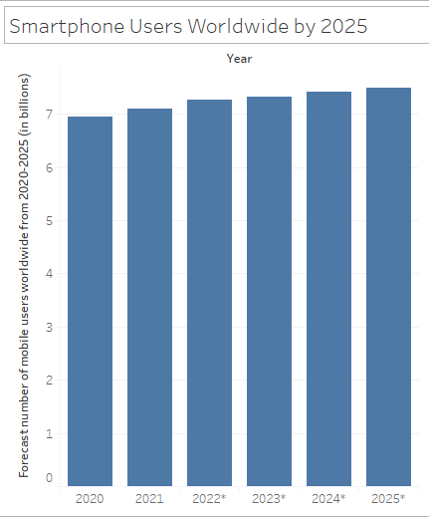
Smartphone Users Statistics
By 2025, the global engagement with smartphone is expected to reach 7.49 billion. An estimated 8.55% growth within next 4 years
Source: Statista.com

Slide 6
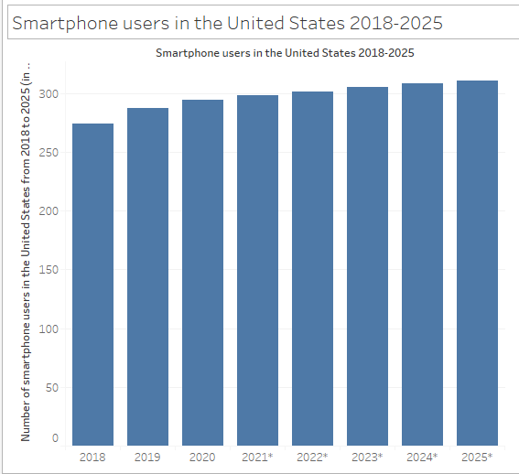
Smartphone Users Statistics
In the United States, there are 290 million smartphone users as of 2021
By 2025, that number is projected to reach 311 million
Source: Statista.com

Slide 7
So, What is Smartphone Addiction?
Smartphone addiction unlike a drug-related addiction is an extreme dependency or fixation with the very devices we use. It is the tendency to use smartphone more than what is considered normal.
An average person checks their phone 58 times a day.

Slide 8
Generally Speculated Effects
Physical (ex: inactivity, unjust habits)
Emotional (ex: loss of joy)
Mental (ex: compulsiveness)
Psychological (ex: mild depression)
Behavioral (ex: change in personality)

Slide 9
Research Questions
1. What personal habits (i.e., smoking, alcohol drinking, and religious practices) candidates have that were susceptible to excessive smartphone usage?
2. For what activities (i.e., texting, calling, reading news, entertainment, other reasons) of smartphones led to excessive usage?
3. Is there any relationship between different effects (i.e., decrease in sleep quality, ability to stop worrying, not being able to enjoy a meal) and personality types (i.e., Type A and B)?
4. Which personality type (i.e., Type A or B) is more vulnerable to the effects (i.e., anxiety, compulsive behavior, functional impairment) of excessive smartphone usage?

Slide 10
Quick Note on Personality Type
Personality Type 0 (A)
Easy-going
Laid-back
More relaxed
Patient
Personality Type 1 (B)
Aggressive
Competitive
Cynical
Mistrustful

Slide 11
Quick Note on Extent of Candidates Response
1 = Strongly Disagree
2 = Somewhat Disagree
3 = Somewhat Agree
4 = Strongly Agree

Slide 12
Acquiring Dataset
Dataset Search
Dataset Retrieval
Dataset Preparation
Creating Datasets by Splitting (activity.xlsx, effects.xlsx and scores.xlsx)
Dataset Modification
Changing Datatype on Personality Variable

Slide 13
Analysis
Statistical Analysis | Basis | Visual Analysis
Activity.xlsx, Effects.xlsx | Dataset | Scores.xlsx
RStudio | Tools | Tableau
Question No. 1, 2 and 3 | Analyzes | Question No. 4

Slide 14
Methods and Procedures of Statistical Analysis
Correlation Matrix (for variable dependency)
Cohen’s D (for mean comparison)
Akaike Information Criterion (AIC) (for variable selection
Multinominal Regression (for checking association among dependent and independent variables)

Slide 15
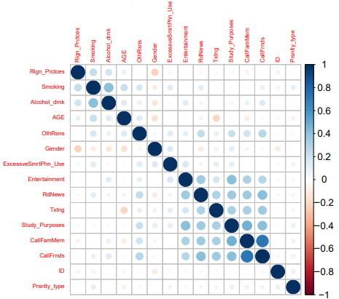
Analysis of Activity.xlsx Dataset
Variables “CallFamMem” and “CallFrnds” have a strong positive
relationship.
Correlation matrix of Activity.xlsx

Slide 16
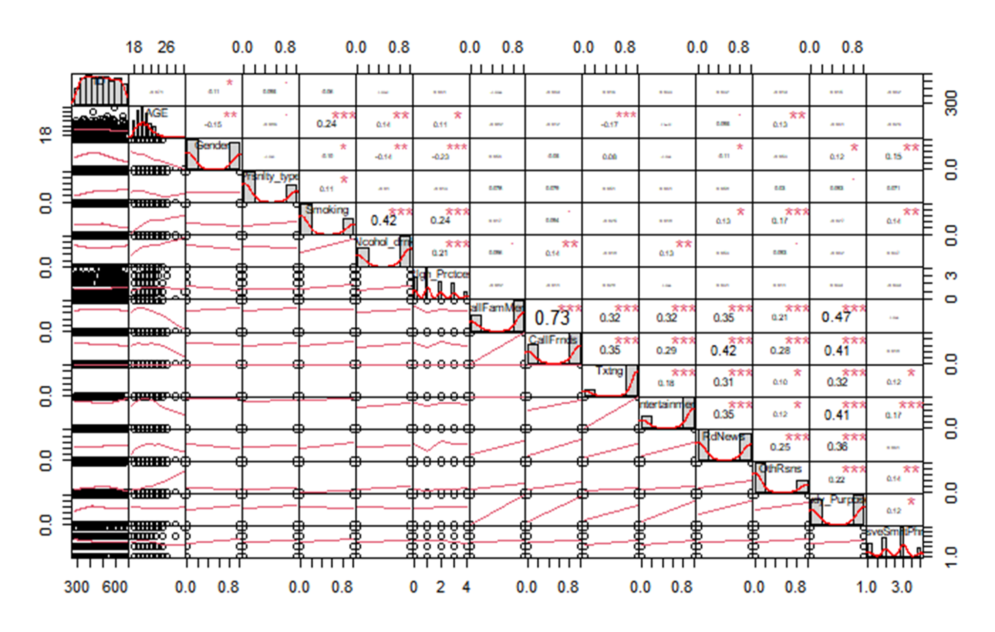
Analysis of Activity.xlsx Dataset
Correlation Graph of Activity.xlsx

Slide 17
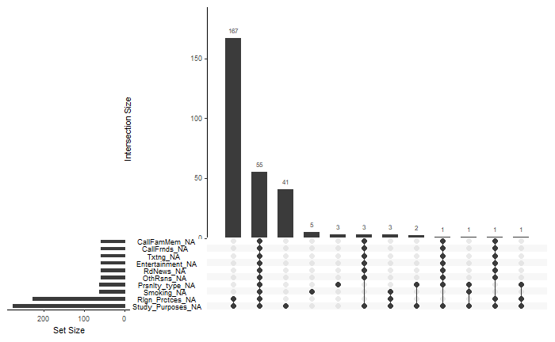
Analysis of Activity.xlsx Dataset
“Rlgn_Prctces” had a total of 227 and “Study_Purposes” has a total of 275 missing data.
Bar graph of missing data in Activity.xlsx datasets

Slide 18
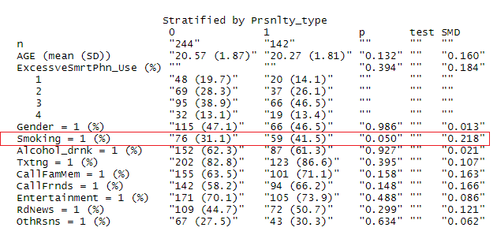
Analysis of Activity.xlsx Dataset
Summary of standard mean difference with Cohen’s D by personality type
“Smoking” retained a perfect size effect of 0.2

Slide 19
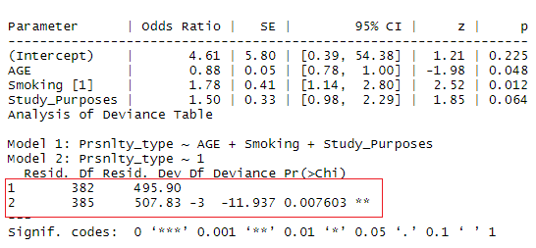
Analysis of Activity.xlsx Dataset
Variables retained an AIC of 495.90 from the original value of 507.83 which proves our variables has validity since the resulting model came out to be lower.
AIC with a backward algorithm

Slide 20
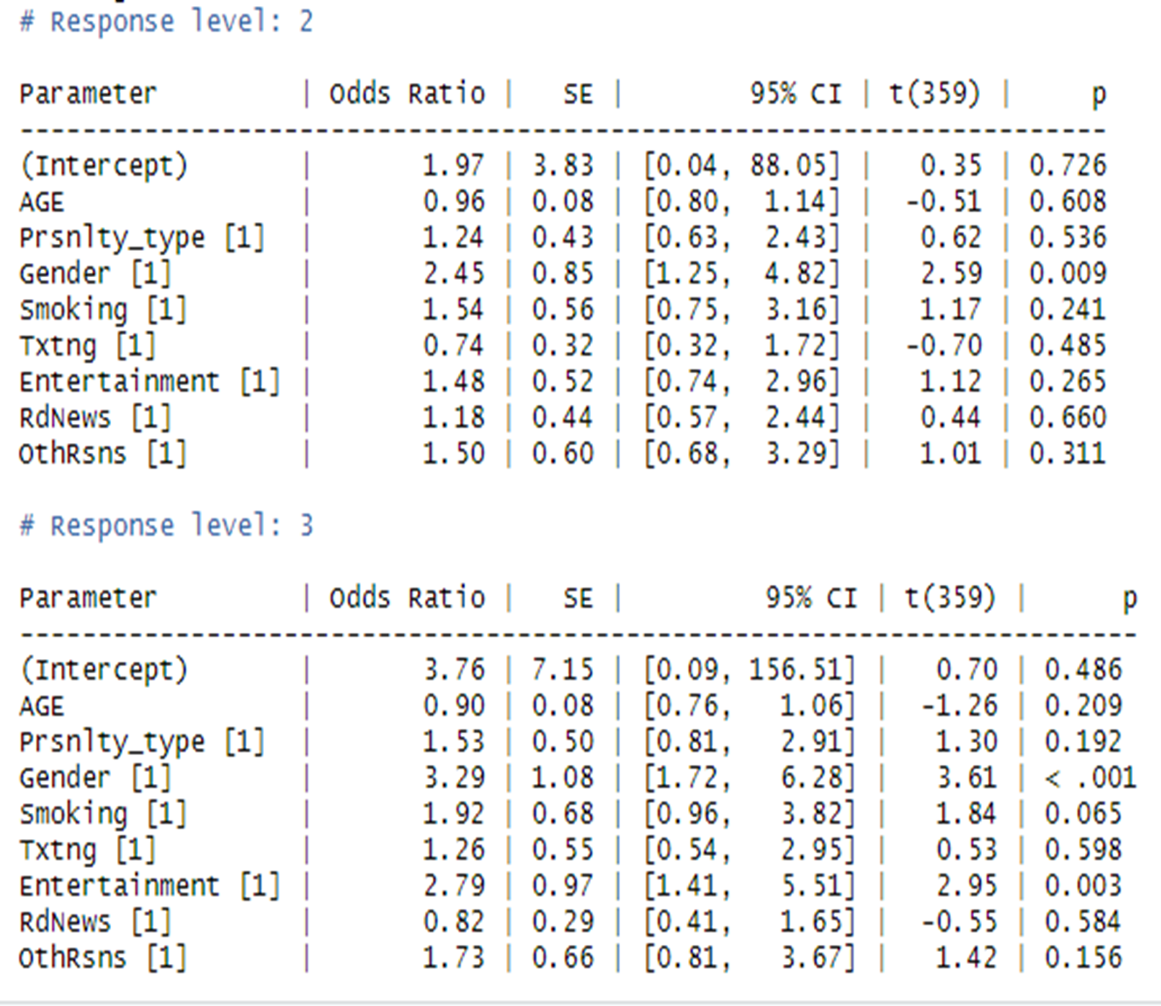
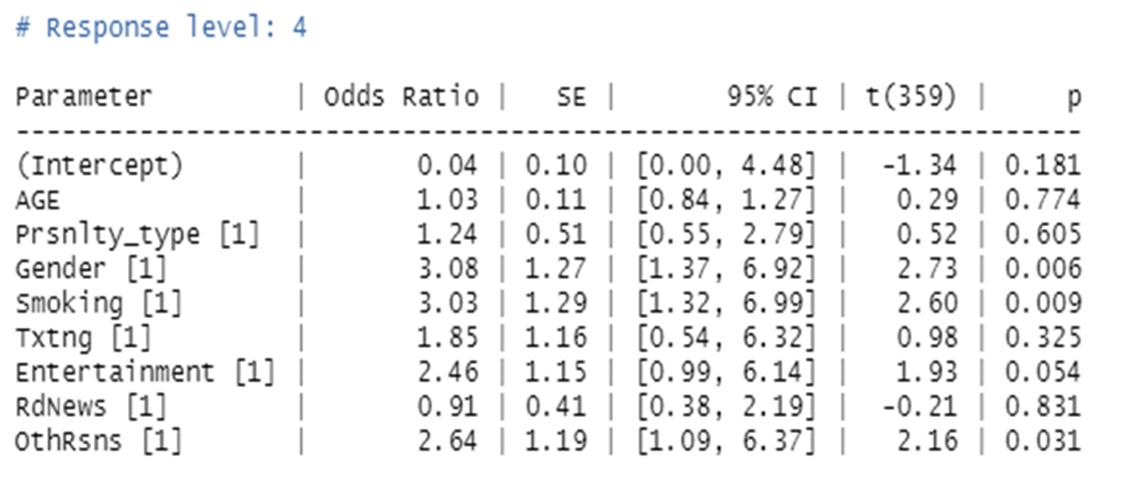
Analysis of Activity.xlsx Dataset
Multinomial regression response level 2, 3 and 4 on the basis of 1 as a reference point.

Slide 21
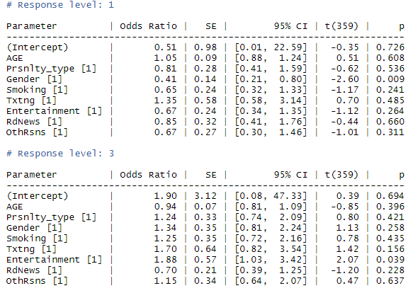
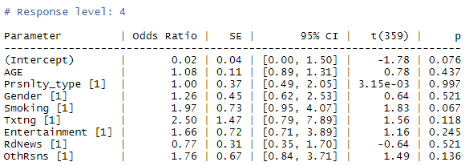
Analysis of Activity.xlsx Dataset
Multinomial regression response level 1, 3 and 4 on the basis of 2 as a reference point.

Slide 22
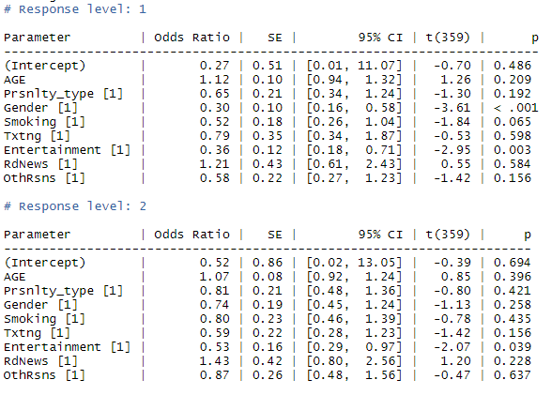
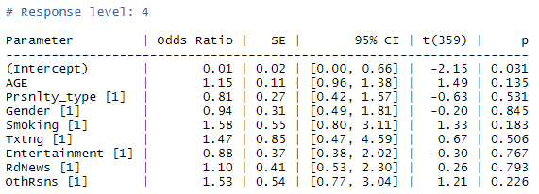
Analysis of Activity.xlsx Dataset
Multinomial regression response level 1, 2 and 4 on the basis of 3 as a reference point.

Slide 23
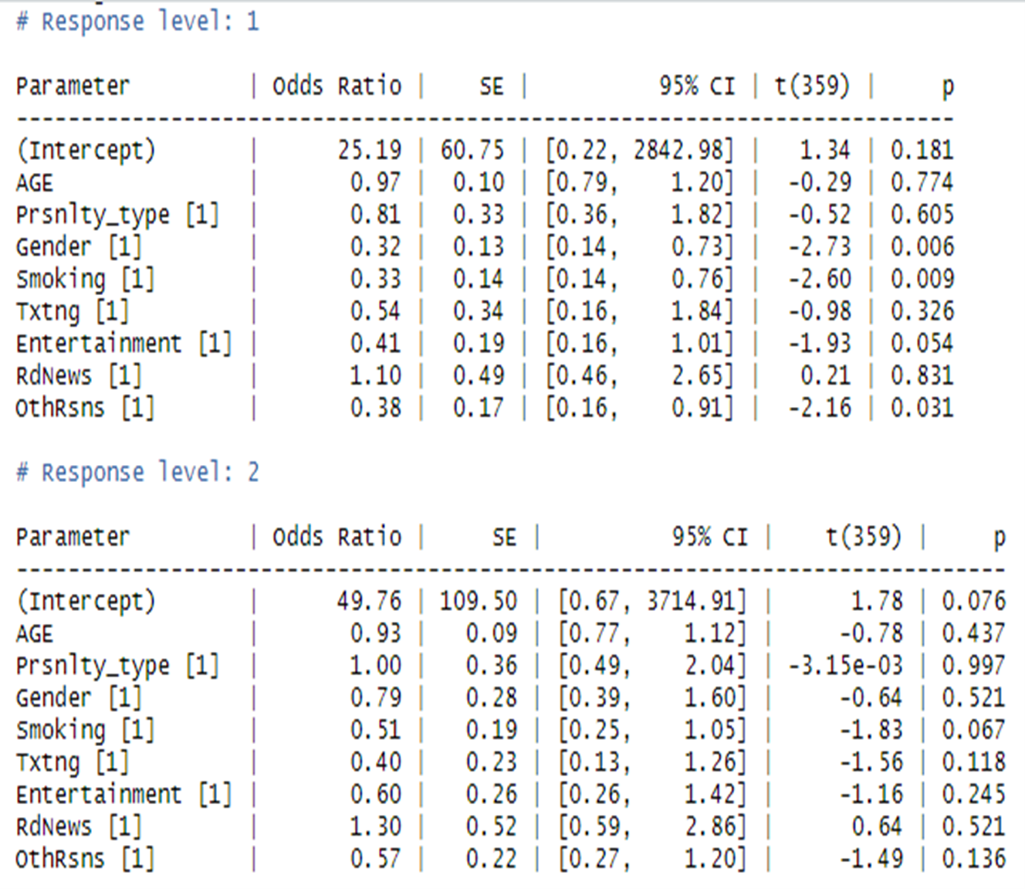
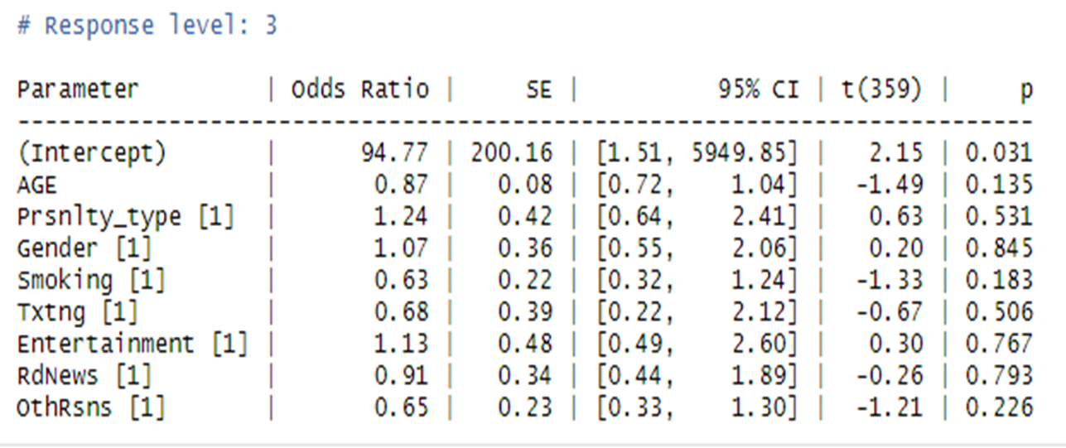
Analysis of Activity.xlsx Dataset
Multinomial regression response level 1, 2 and 3 on the basis of 4 as a reference point.

Slide 24
Analysis of Activity.xlsx Dataset
Key Insights from Multinomial Regression
From response level 1
“Entertainment” had the highest odds ratio in all response levels 2, 3, 4 with a value of 1.48, 2.79, and 2.46 respectively.
“Txtng” had the increasing odds ratio in all response levels 2, 3, and 4 with a value of 0.74, 1.26, 1.85 respectively
From response level 2
“RdNews” had the second-highest increasing odds ratio in all response levels 1, 3, and 4 with a value of 0.85, 1.15, and 1.86 respectively.
“Txtng” had the increasing odds ratio in all response levels 1, 3, and 4 with a value of 1.35, 1.70, and 2.50 respectively
From response level 3
“Txtng” had the highest increasing odds ratio of 0.79, 0.59, 1.47 in response levels 1, 2, and 4 respectively.
“Entertainment” had the second-highest increasing odds ratio of 0.36, 0.53, 88 in response levels 1, 2, and 4 respectively.
From response level 4
“RdNews” had the highest odds ratio in response levels 1 and 2 with a value of 1.10 and 1.30 respectively.
“Txtng” retained the second-highest odds ratio in response level 1 with a value of 0.54.
“OthRsns” had an increased odds ratio in response levels 1, 2, and 3 with a value of 0.38, 0.57, 0.65.

Slide 25
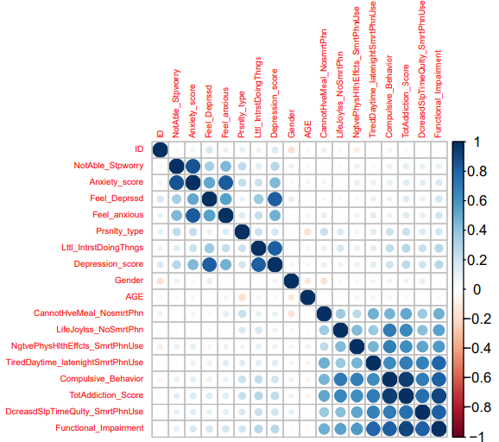
Analysis of Effects.xlsx Dataset
Variables like “TotAddiction_Score”, “Compulsive_Behaivor”, “Depression_Score”, “Anxiety_score” and “Functional_Impairment” showed a high correlation.
Correlation matrix of effects.xlsx

Slide 26
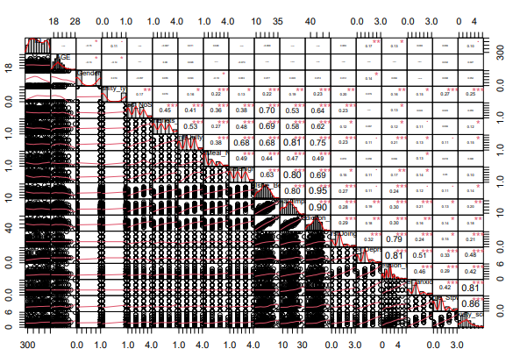
Analysis of Effects.xlsx Dataset
Correlation graph of Effects.xlsx dataset

Slide 27
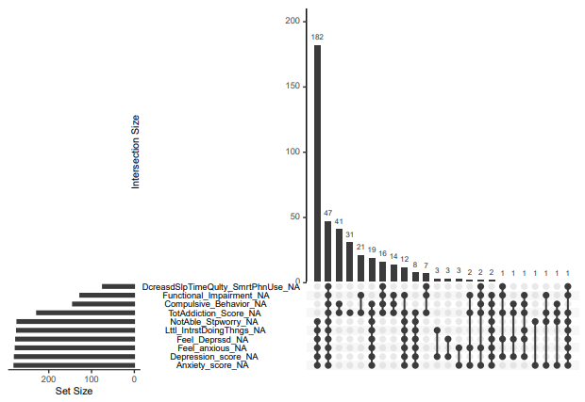
Analysis of Effects.xlsx Dataset
Most of the variables like “Anxiety _score”, “Feel_Deprssd”, “Lttl_IntrstDoingThngs” etc. are well over 200. We cannot exclude them since the exclusion will leave us with few variables for the analysis from which the accuracy of the result can be compromised.
Bar graph of missing values from effects.xlsx dataset

Slide 28
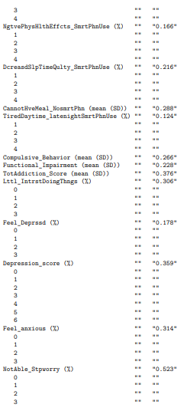
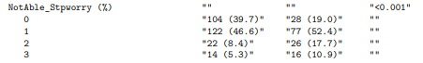
Analysis of Effects.xlsx Dataset
Variables “DecreasdTmeSlpQulty_SmrtPhneUse”,” CannotHveMeal_NosmrtPhn” “Compulsive_Behavior” and “Functional_Impairment” retained a perfect size effect of 0.2. Meaning they are statistically significant in the effects.xlsx dataset.
Since “Lttl_IntrstDoingthngs” and “NotAble_Stpworry” retained a size effect of 0.306 and 0.523 respectively they were used for AIC alongside “CannotHveMeal_NoSmrtPhn” which retained a perfect size effect of 0.288.
Standard mean difference with Cohen’s D in effects.xlsx dataset

Slide 29
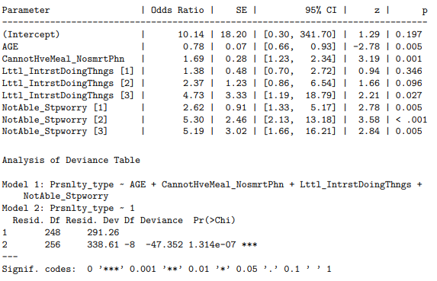
Analysis of Effects.xlsx Dataset
Selected Variables were able to retain a lower AIC of 291.26 from 338.61, proving that selected variables are valid.
AIC in select variables

Slide 30
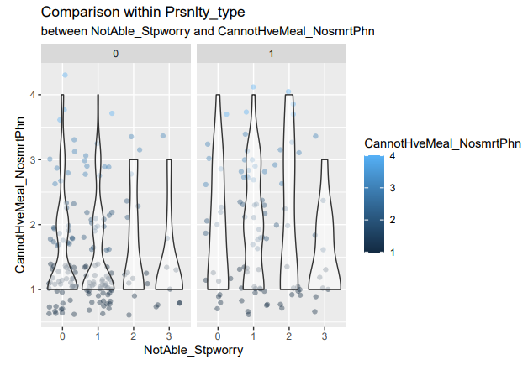
Analysis of Effects.xlsx Dataset
Personality type 1 (B) has more thickness and spread out than personality type 0 (A).
Meaning, effects like not being able to stop worrying and inability to enjoy a meal has more impact on personality type 1 or B.
Violin plot of selected variables in different personality types

Slide 31
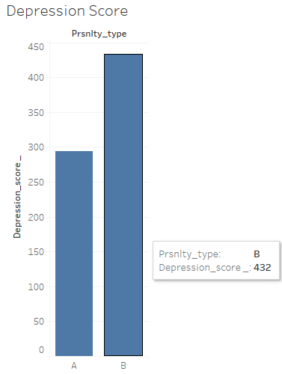
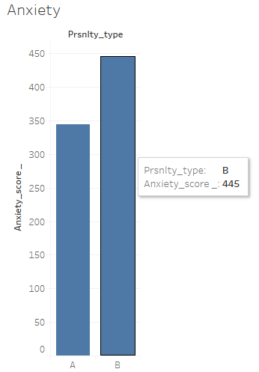
Analysis of Scores.xlsx Dataset
Bar graph of the variable “Depression_score” on
two personality types.
Bar graph of the variable “Anxiety” on
two personality types.

Slide 32
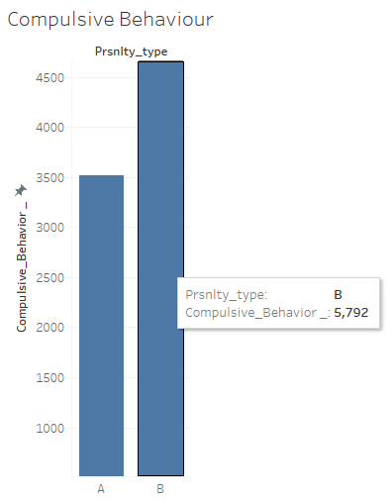
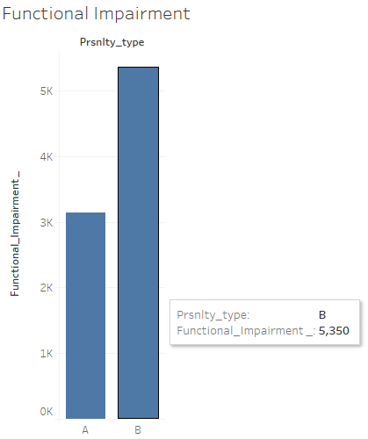
Analysis of Scores.xlsx Dataset
Bar graph of “Compulsive_Behavior” among two personality types
Bar graph of “Functional_Impairment” among two personality types

Slide 33
Summary and Conclusion
Smoking was found to have a strong relationship with excessive smartphone usage smart people.
Texting and entertainment showed a strong association among participants who admitted to excessive smartphone usage.
Effects like decrease in sleep time, inability to enjoy a meal, general loss of interest in doing things, and ability to stop worrying were seen to have prominent impact on candidates.
Candidates with Personality type 1 or B were susceptible to these effects
Personality type 1 or B scored high on every SPAI based measures of anxiety, compulsive behavior, functional impairment and so on. This concludes personality type 1 or B is more vulnerable to psychological effects.

Slide 34
Limitation and Potential
Limitations
No categorization of certain variables
Possible biases due to self-reporting of few qualitative variables
Possible Inaccuracies due to missing data
Potential
Huge dataset extends the possibility of analysis
New iterations of analysis
New research question can be formed

Slide 35
The End

